Slide 1

Machine Learning for Search Engine Relevance
Yashaswini Dhatrika
29th Feb,2020
Notes:
Hello Everyone, I am Yashaswini Dhatrika, master student from Indiana University Bloomington. Today I would present about the Applied Machine learning for searve engine relevance there by optimizing the search engine results

Slide 2
Yashaswini Dhatrika
Master Student in Data Science at Indiana University Bloomington, with a solid data science background, research experience and ~3-years of professional experience in Machine Learning and Statistical Modelling.

Slide 3

Overview
Objective
Context
Approach
Overview of Data
My Hypothesis
Exploratory data analysis of data
Model Implementation
Performance
Key Takeaways
Notes:
I would like to brief you about how I’ll be going forward with the presentation:
We will look at the the key objective of our project
And look a little further into it by discussing the context, the data I have used for the and the hypotheses I have come up with
Leveraging the data and hypothesis I have conducted some exploratory analysis followed by modeling where we dive deep into how factors are affecting our search relavence.
The Flow of presentation would be first I would discuss the key objective, setting up a context to have a better understanding of a problem and then the steps or approach to solve the problem, then introduction to the data. Then I would discuss my Hypothesis which I formulated after observing the data. And then some Exploratory Data Analysis ( Univariate and Bivariate analysis) to get a better sense of data. And Model Implementation and discussing also the why a particular model is considered for this problem and then comparing a model performance. And finally I would discuss the key takeaways.

Slide 4

Objective: 1. As a data scientist for a Search Engine Company , the objective is to develop an ML Algorithm to optimize the search engine relevance by identifying the key drivers impacting the relevance
Notes:
As we know that topic relevance is utmost important for search engine optimization, today we would explore and identify the key drivers impacting the relevance and apply ML algorithm to predict the relevance.

Slide 5
Context
Search engines do try to return relevant results in response to a query, but that definition of relevance is a dynamic and shifting one that doesn't always depend upon whether or not the keywords from a query match keywords used on a page in the page title, heading, content, and in anchor text pointed to that page
Therefore making it a challenge for the search engine to always accurately deliver the user needs.
Notes:
1. “What is Relevance: the ability (as of an information retrieval system) to retrieve material that satisfies the needs of the user.”
2. Relevance in context of webpages is used to indicate how relevant a website is in relation to a search term or topic. The topic relevance is of utmost importance for search engine optimization. The basic message is: The better a text or the content of a page matches a search query, the more likely it is that it will achieve a good ranking.
3. Interesting evolution of Search Engine relevance, before it was query match between keyword used on the pages, but now it is not just that but takes care of location details , historical search patterns of the person and historical pattern in general.
4. For example now if search for virus, then first time we can see is that coronavirus, so basically google is incorporating the past query log files .

Slide 6
Approach-Data Science Framework
Data Preprocessing
(Feature Engineering and Data Cleaning)
1
2
Exploratory Data Analysis
(Finding any relations or trends considering multiple features)
3
Predictive Modeling
(Classification Models like Logistic Regression, Random Forest and SVM)
4
Recommendations and actionable insights
Notes:
Missing value treatment and outlier treatment( some models are sensitive to outlier) Like Logistic regression is sensitive to outlier
EDA: Univariate analysis( to check the distribution of target variable to see if there balanced or imbalanced) / Because certain algorithm would prefer balance data
Also it is important to check the distribution of the predictor variables as certain models like logistic separates the target by line not by any non-linear bounry then it is important to make some transformations before feeding into the models (Esp. if the distribution is skewed)
Bivariate Analysis, to check the correlation of two variables because for some of the model's variable interactions needs to be taken care
For example in our case if we can see how being a website a homepage or not , how it the distribution of relevance
Predictive Modelling: Based on research paper, in which the 13 classification models are ran on 165 datasets, some of top performers are Logistic, Random Forest and SVM
And finally I would discuss about the key takeaways and actionable insights from all the analysis and modelling

Slide 7
Overview of data
~80 K
10
Records
Features
Relevance (0/1)
Search Engine
Predictor
Domain
Notes:
The data has 10 features for given query searches and suggested URLs. For each record the relevance is tagged if the suggested URL is relevance for the requested query. And in totality there are close to ~80 K records

Slide 8
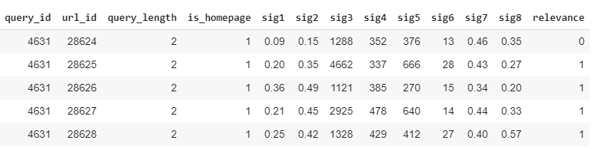
Overview of data
Notes:
This is how the data looks, for a requested query what was the suggested URL and then relevance tag that whether the Suggested URL is relevance or not and there are other variable like what is the query length and if the suggested URL is homepage or not

Slide 9
Hypothesis
With increase in query length, the relevance increases
URL being homepage or not would effect increase relevance.
Other unlabeled variable would effect the relevance
Notes:
Observing the data, I have formulated the following hypothesis,
With increase in the query length , the relevance should increase
If suggested URL is homepage, then it is likely that the suggest URL is more relevant
As other variables are unlabeled, and I would consider that these variable effect the relevance in some way.

Slide 10
Quantify “Relevance”
Notes:
As we discussed priorly it is very important to understand the distribution of target variable, because if the target variable isn’t equally distributed , then during our training and testing split then we need to use sampling techniques like oversampling or under sampling or stratified sampling. As the distribution is equal then we can go with random sampling technique

Slide 11
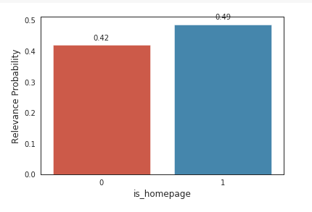
Categorical data and its correlation with Target
Chi-square test: The Chi Square statistic is commonly used for testing relationships between categorical variables..
Results of Chi-square test of Categorical and Target variable shows that the two variable are dependent or correlated
Notes:
As from the pie chart we can observe that 73% of data points have the suggested URL being Homepage and rest of them aren’t homepage
From the bar graph we can observe that for all the suggested URL being homepage, there is nearly equal chance that it can be either relevant or not relevant.
To check if the Home page variable effects or if there any relation exists on Relevance, I have performed the Chi-Square Test
The null hypothesis of the Chi-Square test is that no relationship exists on the categorical variables in the population; they are independent whereas alternative says that there is relationship
Results of Chi-Square test shows that they are dependent at signifanct level of 0.05%

Slide 12
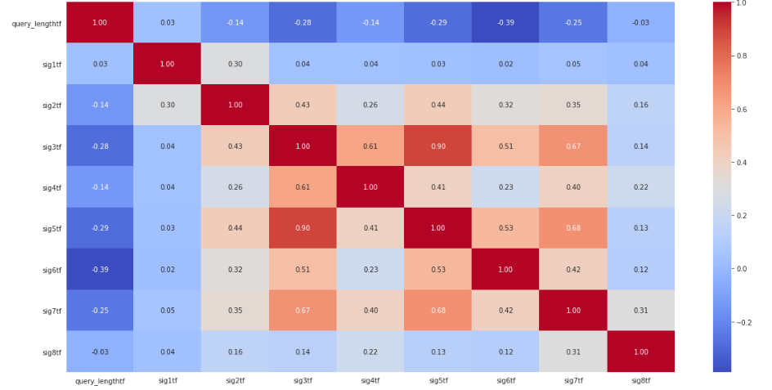
Correlation between continuous variable
Notes:
Person Correlation is performed on the predictor variables to check the interactions. A Pearson correlation is a number between -1 and 1 that indicates the extent to which two variables are linearly related. That is if the interaction is positive then it says that there is positive correlation and if the number is negative then it is negatively correlated. In our data, we could observe that sig5 and sig 3 are highly correlated and sig 7 and sig 5. As certain models , wouldn’t give accurate results in case of interactions between variable so it is important to consider the interactions while implementing the model

Slide 13
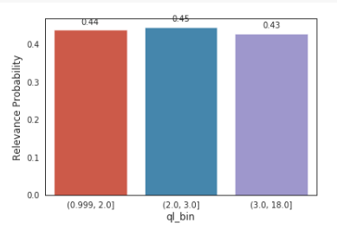
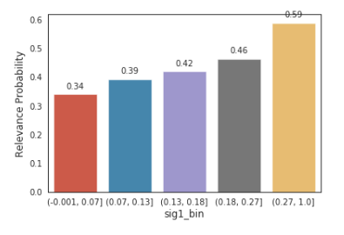
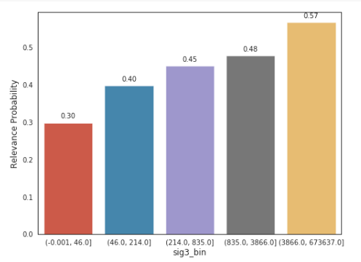
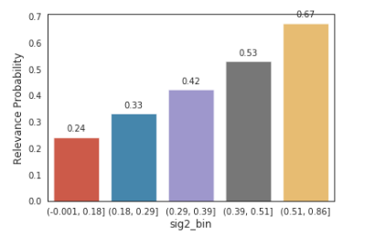
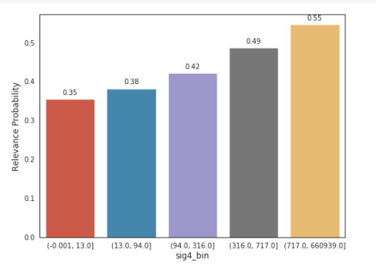
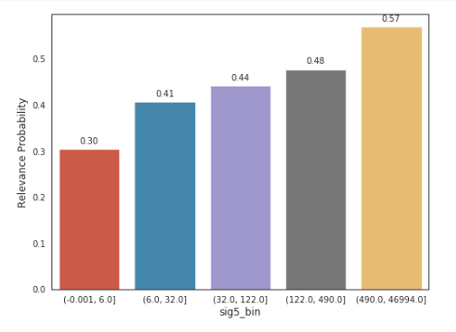
Binned Continuous Variable Vs Target Variable
Notes:
The predictive variables are grouped into equal bins and checked for the Relevance probability for each bin. It seems that except for query length, rest of all the continuous predictors the relevance probability increases as the value of the bin increases.

Slide 14
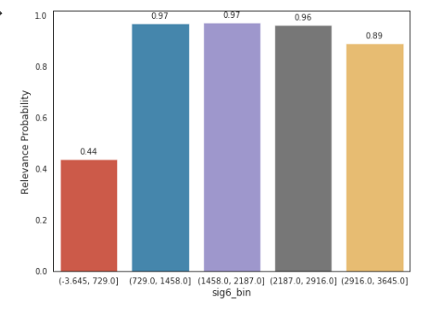
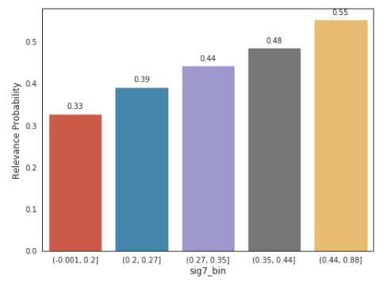
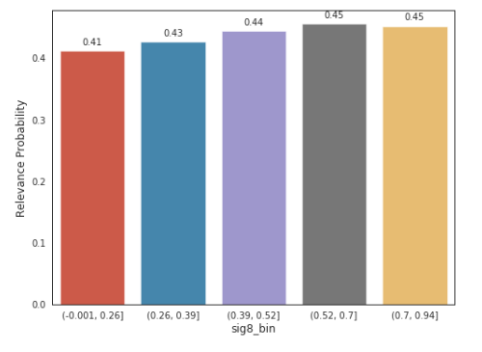
Binned Continuous Variable Vs Target Variable

Slide 15
Is relevance affected by all the variables given
T-test can be performed to answer to question
A t-test is a type of inferential statistic used to determine if there is a significant difference between the means of two groups, which may be related in certain features.
Upon performing the t-test, Variables are associated (reject H0) significance=0.050.
Notes:
Then based on the bivariate analysis performed, I had a question in mind, if the relationship between is statistically significant or not. So for that I have performed T-test. So again t-test is a hypothesis t test where the null hypothesis says that there isn’t any significant difference between the means of two groups, whereas the alternative hypothesis says that there is a significant difference between the means of two groups.
Results of t-test test shows that the means of two groups is significant at 0.05%

Slide 16
Modeling

Slide 17
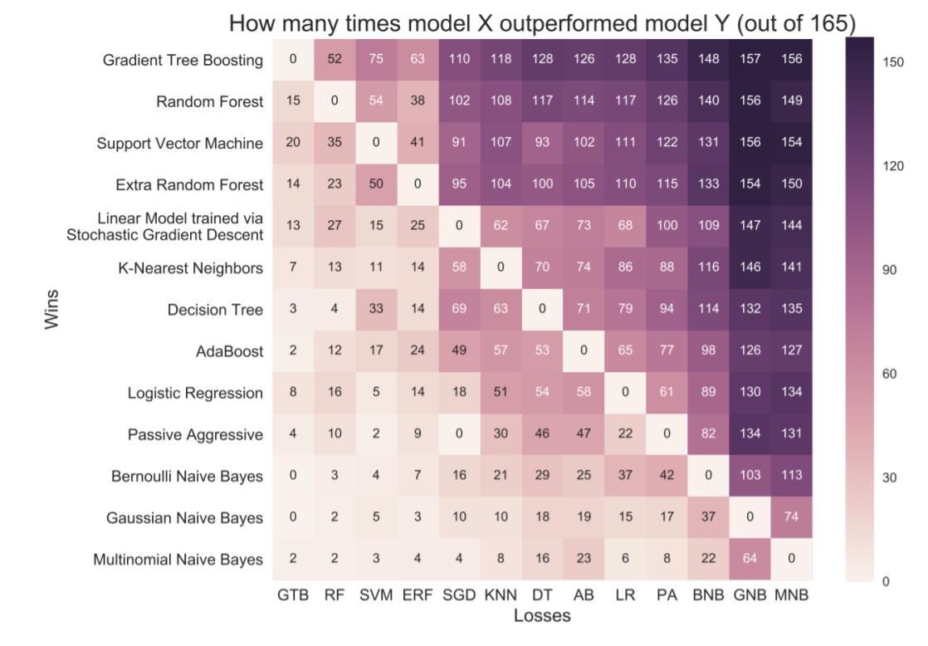
Model Comparison
Notes:
As we discussed earlier, this visualization says that Random Forest SVM and Logistic Regression are top performer models when a study is conducted on 165 data sets and 13 different classification models are applied, to compare the model performance.

Slide 18
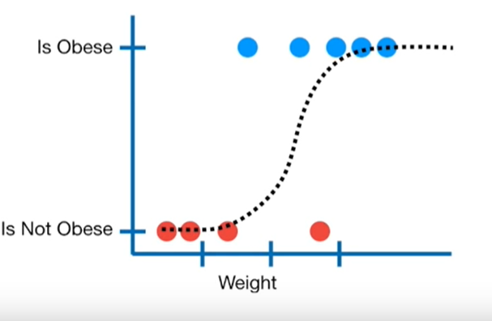
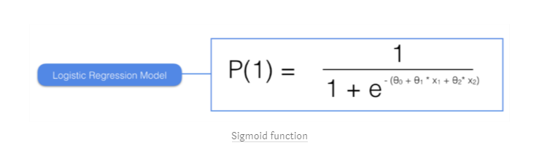
Logistic Regression
It’s a classification algorithm, that is used where the response variable is Categorical. The idea of Logistic Regression is to find a relationship between features and probability of particular outcome.
It is a special case of linear regression.
Notes:
1. It is a classification algorithm where your target variable is categorical. As the range should be in between 0 and 1 so we apply the sigmoid transformation on wX+b so that range of resultant is between 0 and 1. And this is how the sigmoid function looks like.

Slide 19
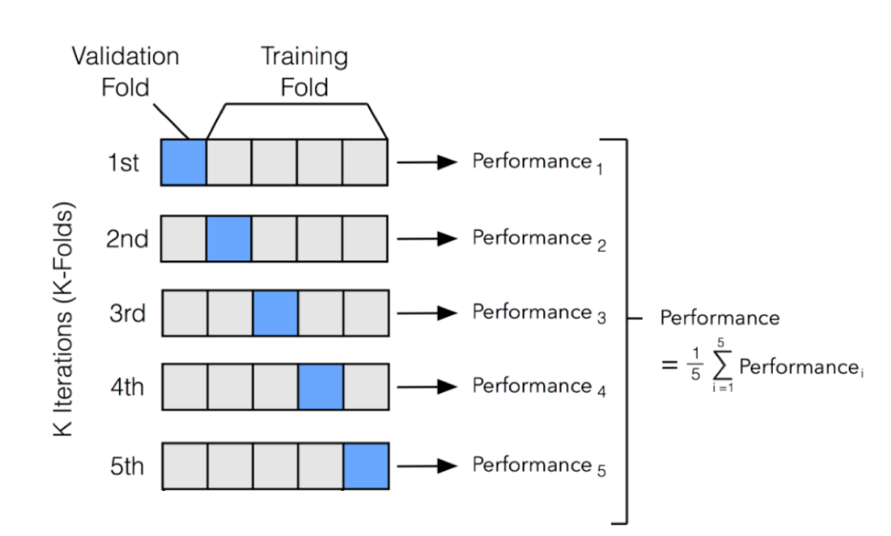
Regularization
Ridge regression adds “squared magnitude” of coefficient as penalty term to the loss function.
Lasso Regression (Least Absolute Shrinkage and Selection Operator) adds “absolute value of magnitude” of coefficient as penalty term to the loss function.
K-Fold
Notes:
Once we select the model, it often happens that model might overfit that is training error is low, but the generalization error is relatively high. So the ideal model should be of low bias (high bias pays very little attention to the training data and oversimplifies the model.) and low variance ( able to generalize on all the datasets)
Some of the methods adopted to prevent overfitting is 1) Regularization is nothing put we are adding some noise to the loss equation so that the model is robust and to avoid complicated models. In other words, this technique discourages learning a more complex or flexible model, to avoid the risk of overfitting.
λ is the tuning parameter that decides how much we want to penalize the complexity of our model. There are two types of regularization one is ridge regression another is lasso regression
Before we go into K-Fold cross-validation, I would like to talk about hyperparameter ,hyperparameter is a parameter whose value is set before the learning process begins. By contrast, the values of other parameters are derived via training. Like in the case of regularized logistic regression you try to find the lambda the amount of regularization you want to put into the loss function. So K –fold cross validation that the total training set is divided into k equal parts, each part is kept for validation and then rest other as training set. Therefore the process ensures that every observation from the original dataset has the chance of appearing in the training and validation set and then total performance is calculated by averaging out all the performance. Then you try to perform by considering different values of hyperparameter then you consider the hypermeter which gives a high accuracy

Slide 20
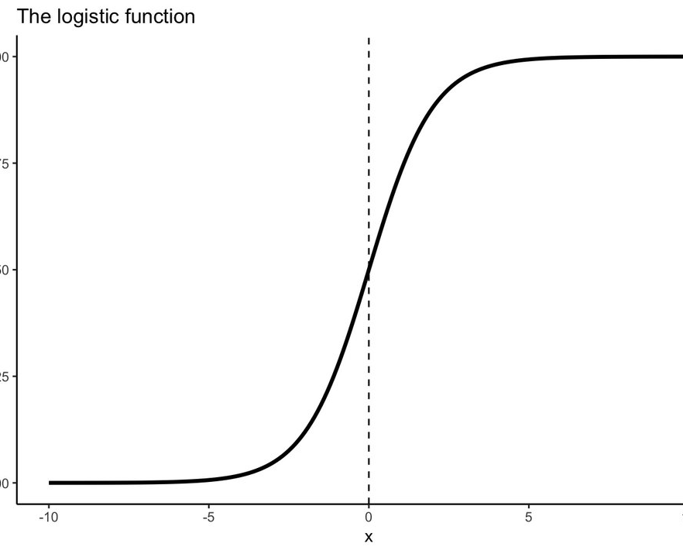
Why Use?
Notes:
Widespread industry comfort for logistic regression for its interpretable trait
Very Intuitive and quantify the relationship between the dependent variable and independent variable (coefficients and then calculate change in dependent variable with one unite change in independent variable
Multi-collinearity is not really an issue and can be countered with L2 regularization to an extent

Slide 21
Implementation
Normalization:
To make the model implementation faster
Split into Train/Test:
80/20 Split
Training and Hyperparameter tuning: Hyper Parameters considers are Inverse regularization parameter and type of regularization (L1,L2)
Tuning method: K cross fold validation
Model Evaluation Metrics:
1. F1 Score
2. Precision and Recall
3. AUC
4. Accuracy

Slide 22
Results
Variable | coeff | % change in odds of page being relevance with unit change in variable
query_length | 0.71 | 103.3991
sig1 | 0.57 | 76.82671
sig2 | 1.54 | 366.459
sig3 | -0.08 | -7.68837
sig4 | 0.25 | 28.40254
sig5 | -0.09 | -8.60688
sig6 | 0.89 | 143.513
sig7 | 0.34 | 40.49476
sig8 | -0.35 | -29.5312
not home page | 0.04 | 4.081077
home page | -0.04 | -3.92106
Notes:
This is the output from the logistic regression, that from the coefficients we can calculated the we can convert coefficients to odds ratios by exponentiating them. We can then interpret the effect of the variable in terms of its effect on the odds . So by doing so we can see that for the one unit change in query length the % change of odds being relevance is change by 103%. In the same fashion we can interpret for the other variables too.

Slide 23
Random Forest

Slide 24
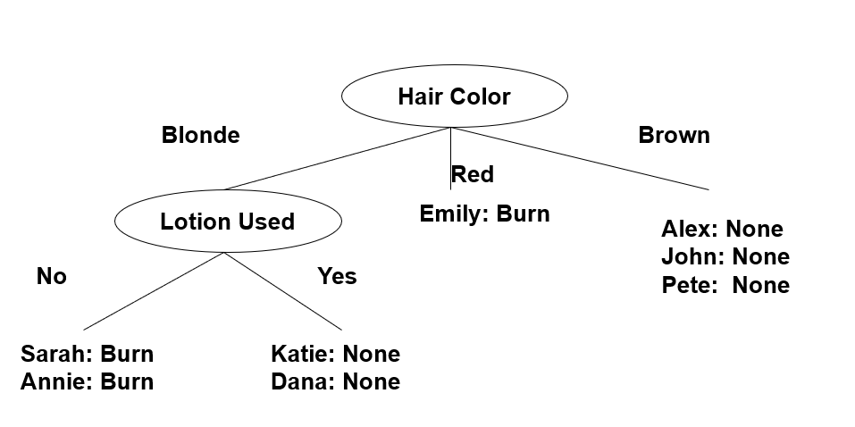
Intuition of Decision Tree
Data SET
Desirable output from Decision Tree
Notes:
Next Algorithm considered is Random forest, the building block of Random forest is decision tree, before jumping to random forest, let me give the intuition behind the random forest. Consider the dataset with 8 people for each of them I know 4 of the attributes either hair color, their height, weight and whether or not they apply lotion or not then I am going to predict whether or not their skin would burn when they are exposed to sunlight. Some of variables are binary and some are multivariate. So the goal of decision tree is to build small tree that all samples at leaves have same colors. So we need to pick up a variable that branches are closed to having same class. So we need to choose a measure that captures the disorderness or randomness at each step.
We can see that on the right side that when u split the data by hair color , 4/ 8 it gave us the desirable outputs and then if we split the Blonde data points based on lotion used then it gives us the desirable output. So this would be a desirable output

Slide 25
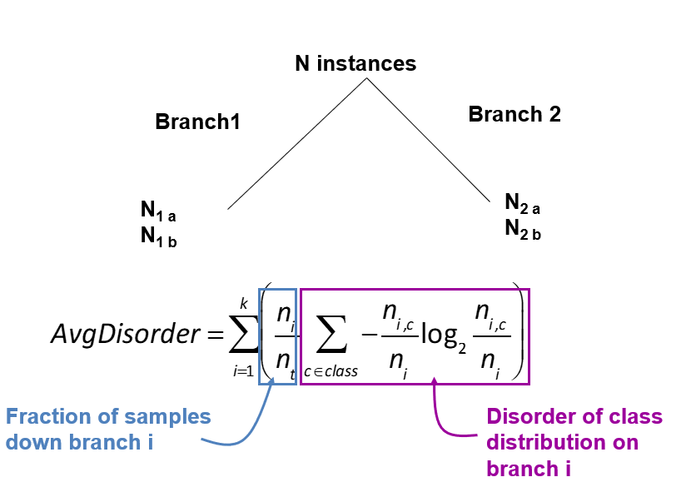
Measuring Disorder- Entropy:
Notes:
1. If you see math behind the decision tree, we chose the variable at each node where Entropy (is degree of randomness) is reduced. This is mathematical formula for the entropy! Please let me if I need to explain the equation , if yes for each branch it calculate the fraction of cluster 1 and then multiplied with log of same fraction and then u can sum for all the clusters in that particular branch, then u do same for the other branch too. Then u take mixture prop and add both of them. Then random forest is nothing but consisting of many decisions trees. Each decision tree is built on random sample of data. Then a prediction is made based on max voting.

Slide 26
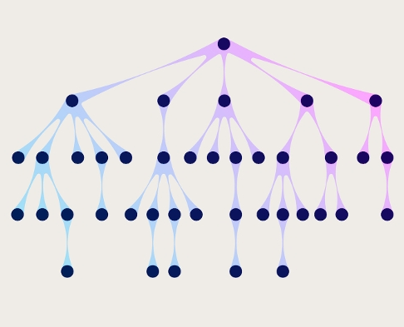
Why Use?
Notes:
The right algorithm can sometimes be the one which is the most simple, the most robust and the most easily understood by your end users. Random Forest will regularly tick all of these boxes
Random Forest works well with a mixture of numerical and categorical features
3. They are parallelizable, meaning that we can split the process to multiple machines to run. This results in faster computation time
4. Robust to Outliers and Non-linear Data: Random forest handles outliers by essentially binning them. It is also indifferent to non-linear features.
5. cutting feature space into rectangles [ or cuboids or hyper-cuboid for higher dimensions ]

Slide 27
Implementation
Split into Train/Test:
80/20 Split
Training and Hyperparameter tuning:
Hyper Parameters considers are number of decision trees, disorder calculating and depth of the tree Tuning method: K cross fold validation
Model Evaluation Metrics:
1. F1 Score
2. Precision and Recall
3. AUC
4. Accuracy

Slide 28
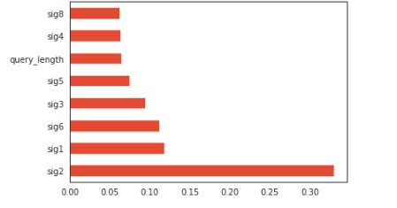
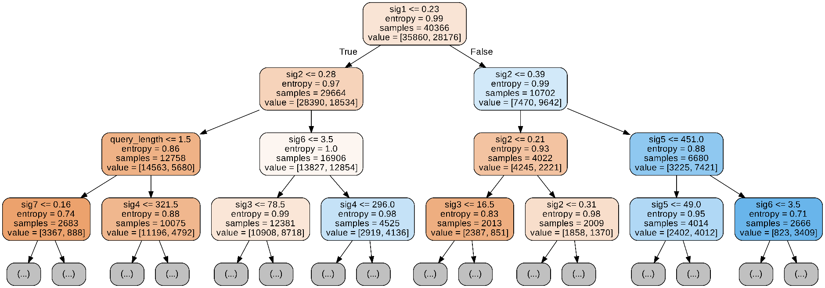
Results
Variable Importance

Slide 29
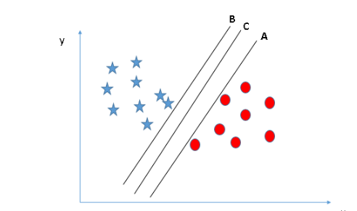
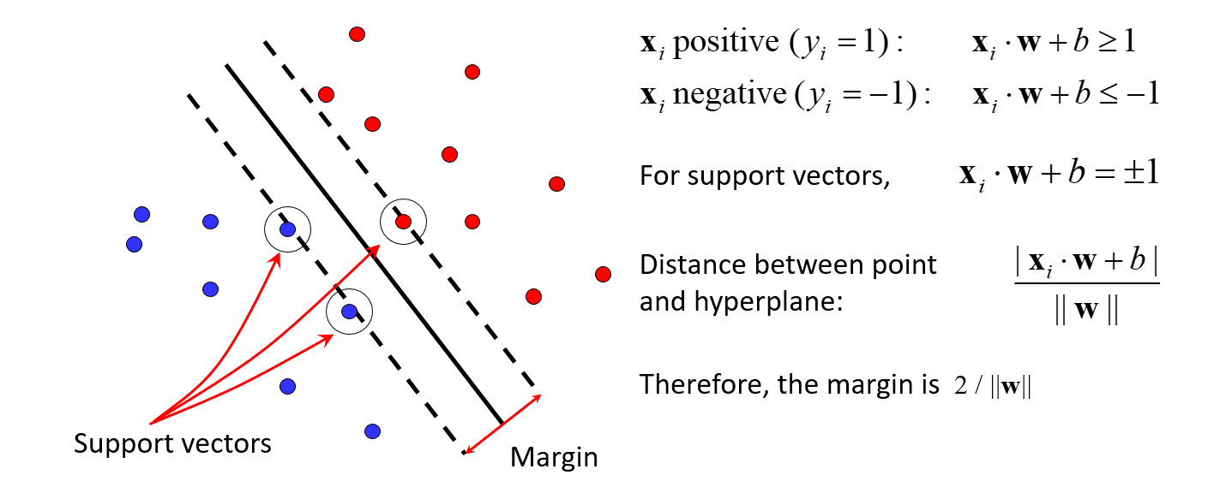
Support Vector Machine
Find hyperplane that maximizes the margin between the positive and negative examples
Notes:
SVM finds a hyperplane to separate the relevant cases and non-relevant cases, suppose consider the left graph where u have A,B, C hyperplane which separates the 2 classes, but if we observe that the hyperplane B is very close the star point, same with the case of the Hyperplane A , but in case of C we can observe that the difference between closest points to the hyperplane is maximized. Then is called Margin.

Slide 30
Why Use?
Notes:
decision boundary produced by logistic regression will always be linear , which can not emulate a circular decision boundary which is required. So, logistic regression will work for classification problems where classes are approximately linearly separable
SVMs (depending on the kernel) provide smoother boundaries compared to random forest for nonlinear relationship.
both the linear and radial-basis kernels performed quite well in the presence of outliers. For these kernels, accuracy on the test sets was unaffected until outliers reached roughly 20% of the training examples. (~ Hoak, J., 2010. The Effects of Outliers on Support Vector Machines. Portland State University.)

Slide 31
Implementation
Split into Train/Test:
80/20 Split
Training and Hyperparameter tuning:
Hyper Parameters considers are penalty and kernal
Model Evaluation Metrics:
1. F1 Score
2. Precision and Recall
3. AUC
4. Accuracy

Slide 32
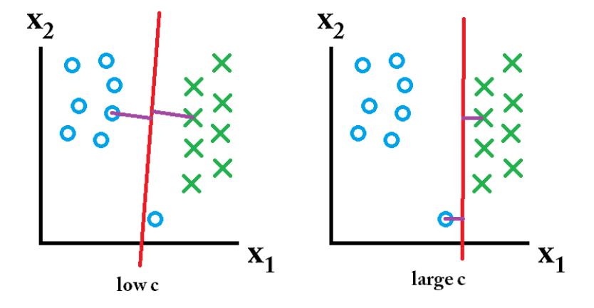
C factor
Notes:
To the left you have a low c which gives you a pretty large minimum margin (purple). However, this requires that we neglect the blue circle outlier that we have failed to classify correct. On the right you have a high c. Now you will not neglect the outlier and thus end up with a much smaller margin.
Rbf kernel: e-gamma(a-b)^2

Slide 33
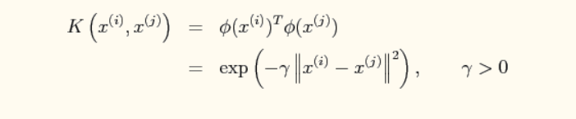
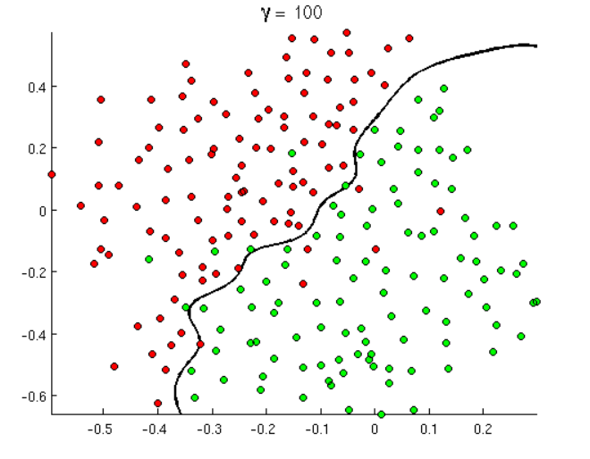
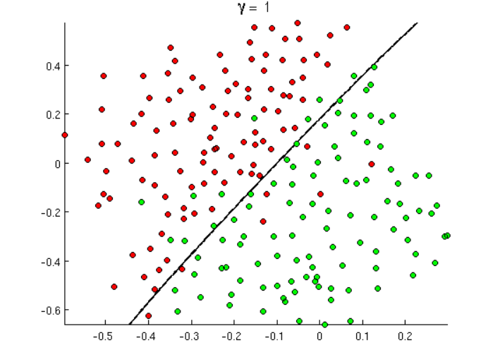
RBF Kernel

Slide 34
Performance comparison

Slide 35
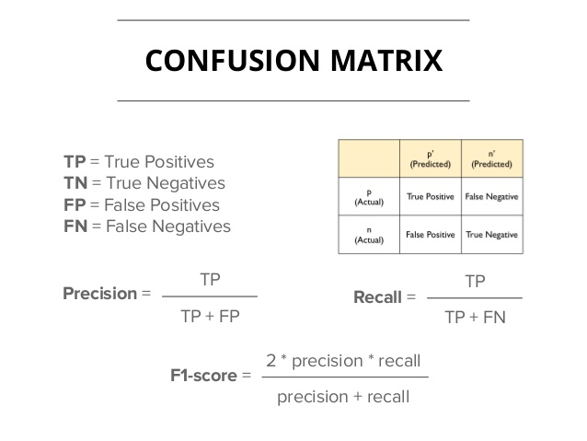
Performance Metrics
Method | Accuracy | F1 score | AUC
Logistic Regression | 0.66 | 0.64 | 0.64
Random Forest | 0.66 | 0.64 | 0.64
SVM | 0.66 | 0.64 | 0.64
Notes:
Before guin into Performance metrics let us look into the confusion matrix, True positive are ones, where the data points are tagged relevant and model predicted as relevant , where as True negative are points where the data points are not relevant results and model predicted too relevant , And false positive ones are predictive relevance but actually they are non-relevance results where as false negative are they are actually relevance but predicted not relevance. From this confusion matrix we can calulate the precision which fraction of TP / Actual Predictied Positive
An Recall is TP/Actually positive. F1 Score is hormonic mean of Precision and recall. Specificity is TN/ Actual Negative The other matrix AOC of ROC. ROC is probability curve where calculate the sensititity and 1-specificity for difference probability threshold, the higher the AUC means the better is the model. We can observe that all the models are performly equally moderately.
In order to pick one then I would go for logistic as we could quantify the relationship
Sensitivity/Recall: (TP/TP+FN)
Specificity :( (TN/TN+FP)
Receiver Operating Characteristics
ROC: TPR(sensitivity) Vs 1-specificity
ROC is a probability curve and AUC represents degree or measure of separability. It tells how much model is capable of distinguishing between classes. Higher the AUC, better the model is at predicting 0s as 0s and 1s as 1s.
When we decrease the threshold, we get more positive values thus it increases the sensitivity and decreasing the specificity. Similarly, when we increase the threshold, we get more negative values thus we get higher specificity and lower sensitivity. As we know FPR is 1 - specificity. So when we increase TPR, FPR also increases and vice versa.

Slide 36
Key Takeaways
ONE:
According to random forest, Unlabeled variable like sig2, sig1 and sig 6 helps to differentiate if the search result is relevant or not
TWO: According to logistic regression ,One unit increase the query length say 103% percent increase in log of odds of suggested page relevant
THREE: According to logistic regression, If the url is not homepage, there is 4% increase in log of odds of relevance

Slide 37
My Suggestions
Notes:
We can observe from logistic regression that SE doesn’t retrieve relevant results for the small query length, may be the engine can pop up saying to add some more information.
It is also observed that being a homepage need not to be more relevant, may be the SE hypothesis that my matching the query with the URL, the homepage is more preferred. Based on the analysis it seems that equal weightage should be give to both of it!

Slide 38
Thank you!

Slide 39
APPENDIX

Slide 40
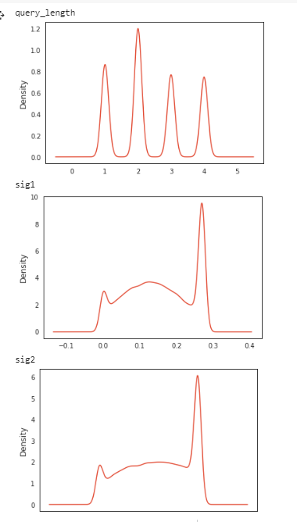
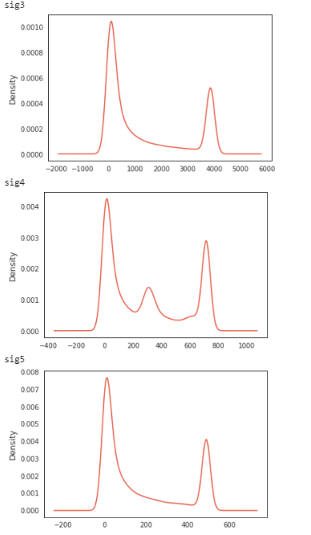
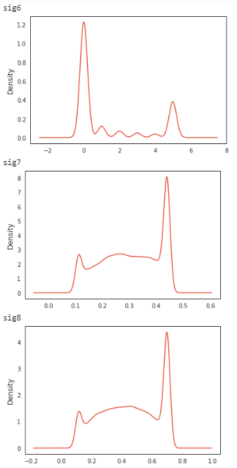
Distribution of Continuous Variable

Slide 41
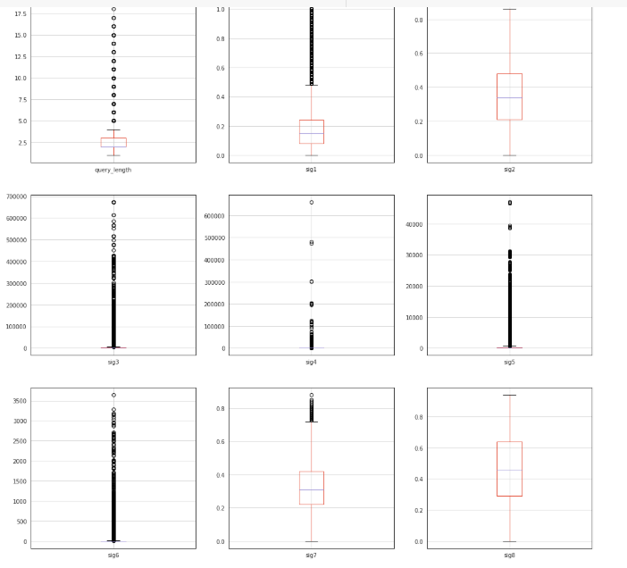
Outlier Detecting using Box plots

Slide 42
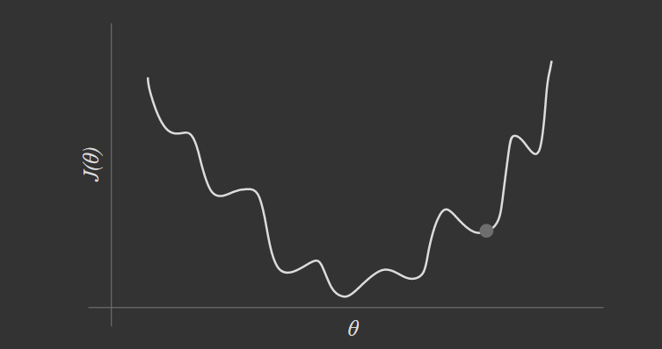

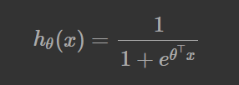
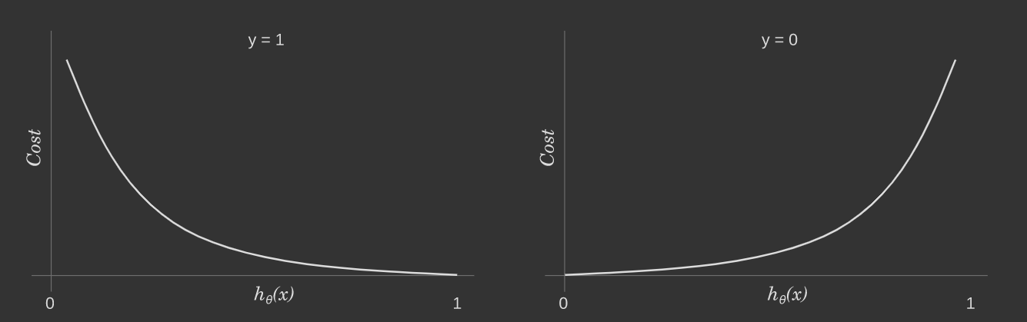
Cost Functions
Cost function if MSE is consider
Modified Cost function

